Slide 1
Managing Azure virtual machines
Configuring virtual machines
Configuring virtual machine disks
Managing and monitoring Azure virtual machines
Managing classic virtual machines
Configuring availability
Implementing desired state configuration (DSC)
Implementing storage space–based volumes

Slide 2
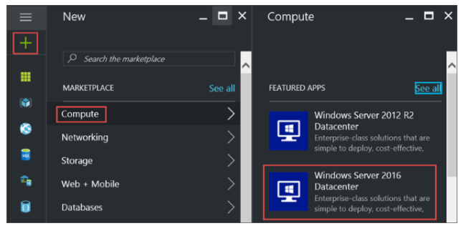
Configuring virtual machines
Sign in to the Azure portal.
Starting in the upper left, click New > Compute > Windows Server 2016 Datacenter.

Slide 3
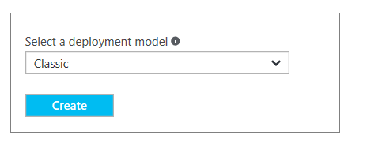
On the Windows Server 2016 Datacenter, select the Classic deployment model. Click Create.
Basics blade
The Basics blade requests administrative information for the virtual machine.
Enter a Name for the virtual machine. In the example, HeroVM is the name of the virtual machine. The name must be 1-15 characters long and it cannot contain special characters.
Enter a User name and a strong Password that are used to create a local account on the VM. The local account is used to sign in to and manage the VM. In the example, azureuser is the user name.
The password must be 8-123 characters long and meet three out of the four following complexity requirements: one lower case character, one upper case character, one number, and one special character.

Slide 4
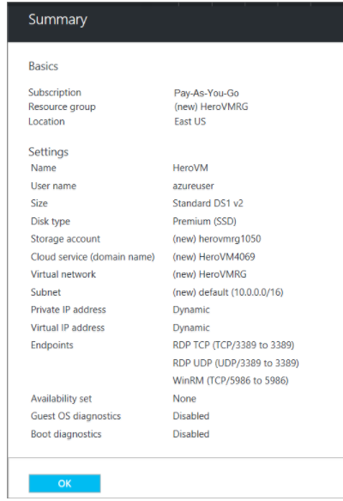
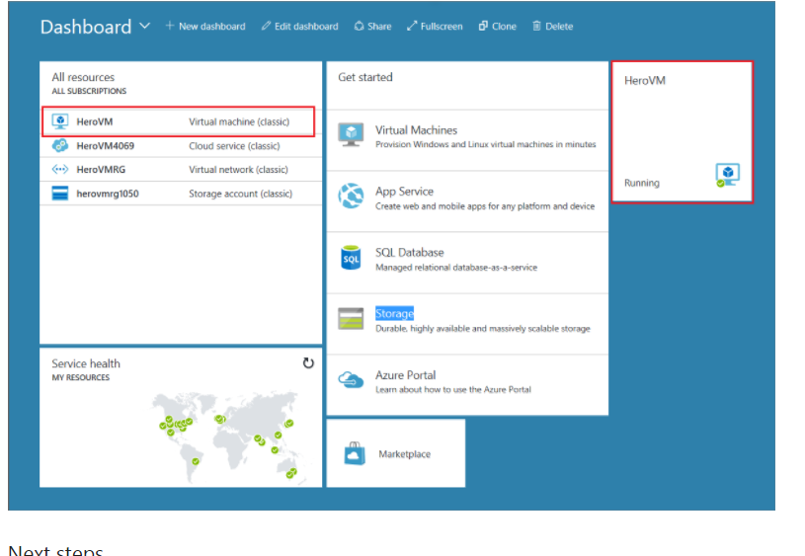

Slide 5
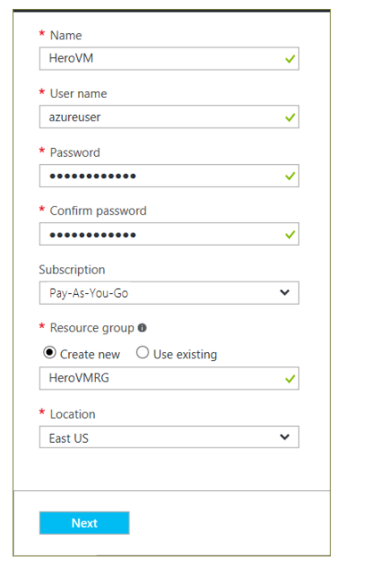
The Subscription is optional. One common setting is "Pay-As-You-Go".
Select an existing Resource group or type the name for a new one. In the example, HeroVMRG is the name of the resource group.
Select an Azure datacenter Location where you want the VM to run. In the example, East US is the location.
When you are done, click Next to continue to the next blade.

Slide 6
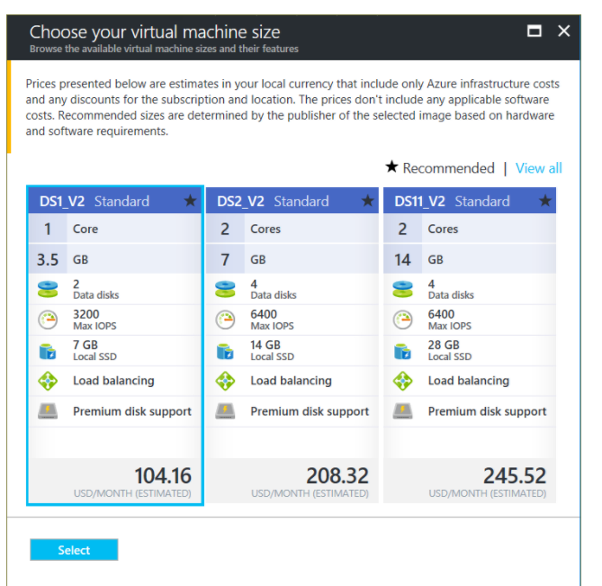
Size blade
The Size blade identifies the configuration details of the VM, and lists various choices that include OS, number of processors, disk storage type, and estimated monthly usage costs.
Choose a VM size, and then click Select to continue. In this example, DS1_V2 Standard is the VM size.

Slide 7
Settings blade
The Settings blade requests storage and network options. You can accept the default settings. Azure creates appropriate entries where necessary.
If you selected a virtual machine size that supports it, you can try Azure Premium Storage by selecting Premium (SSD) in Disk type.
When you're done making changes, click OK.
Summary blade
The Summary blade lists the settings specified in the previous blades. Click OKwhen you're ready to make the image.
After the virtual machine is created, the portal lists the new virtual machine under All resources, and displays a tile of the virtual machine on the dashboard. The corresponding cloud service and storage account also are created and listed. Both the virtual machine and cloud service are started automatically and their status is listed as Running.

Slide 8
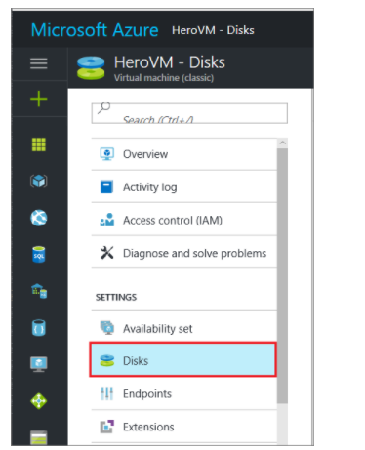
Configuring virtual machine disks
Sign in to the Azure portal.
Select the virtual machine from the resource listed on the dashboard.
In the left pane under Settings, click Disks.

Slide 9
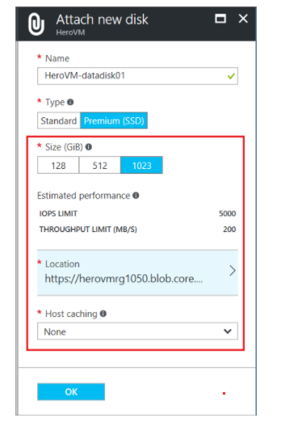
Option 1: Attach and initialize a new disk
On the Disks blade, click Attach new.
Review the default settings, update as necessary, and then click OK.

Slide 10
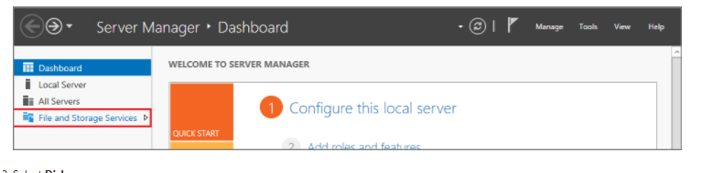
After Azure creates the disk and attaches it to the virtual machine, the new disk is listed in the virtual machine's disk settings under Data Disks.
Initialize a new data disk
Connect to the virtual machine.
After you log on to the virtual machine, open Server Manager. In the left pane, select File and Storage Services.
Select Disks.
The Disks section lists the disks. Most often, a virtual machine has disk 0, disk 1, and disk 2. Disk 0 is the operating system disk, disk 1 is the temporary disk, and disk 2 is the data disk newly attached to the virtual machine. The data disk lists the Partition as Unknown.
Right-click the disk and select Initialize.

Slide 11
You're notified that all data will be erased when the disk is initialized. Click Yes to acknowledge the warning and initialize the disk. Once complete, the partition will be listed as GPT. Right-click the disk again and select New Volume.
Complete the wizard using the default values. When the wizard is done, the Volumes section lists the new volume. The disk is now online and ready to store data.

Slide 12
Managing and monitoring Azure virtual machines
To view and manage backup settings for a virtual machine click the Protected Items tab. Click on the name of a
protected item to see the Backup Details tab, which shows you information about the last backup.
To view and manage backup policy settings for a virtual machine click the Policies tab.
The Backup Policies tab shows you the existing policy. You can modify as needed. If you need to create a new
policy click Create on the Policies page. Note that if you want to remove a policy it shouldn't have any
virtual machines associated with it.
You can get more information about actions or status for a virtual machine on the Jobs page. Click a job in the
list to get more details, or filter jobs for a specific virtual machine.

Slide 13
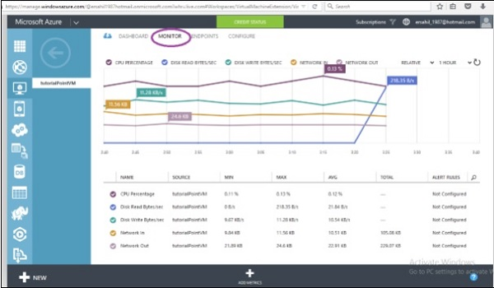

Slide 14
Managing classic virtual machines
The classic virtual system instances are managed by PureApplication Software and can be serviced and accessed through the
console. Classic virtual system instances managed by PureApplication Software are dynamic. Virtual machines can be added
or removed to allow your virtual systems to scale based on current demand. You can increase the capacity of your virtual
machines to scale for increased user demands by creating clones of existing virtual machines. If needed, you can scale down
the environment and remove unnecessary virtual machines.

Slide 15
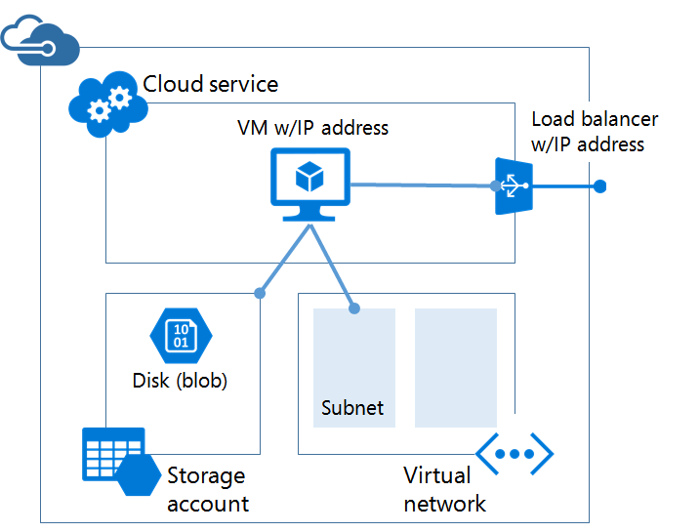

Slide 16
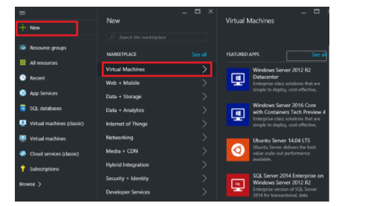
Configuring availability
To use the Azure portal:
If you haven't already done so, sign in to the Azure portal.
On the hub menu, click + New, and then click Virtual Machine.

Slide 17

Select the Marketplace virtual machine image you wish to use. You can choose to create a Linux or Windows virtual machine.
For the selected virtual machine, verify that the deployment model is set to Classic and then click Create
Enter a virtual machine name, user name and password (for Windows machines) or SSH public key (for Linux machines).
Choose the VM size and then click Select to continue.

Slide 18
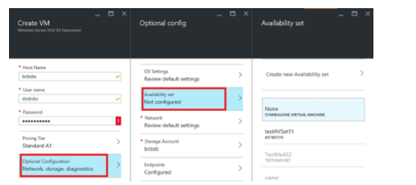
Choose Optional Configuration > Availability set, and select the availability set you wish to add the virtual machine to.
Review your configuration settings. When you're done, click Create.
While Azure creates your virtual machine, you can track the progress under Virtual Machines in the hub menu.

Slide 19

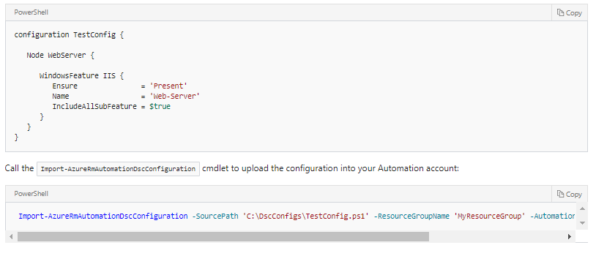
Implementing desired state configuration (DSC)
Log in to your Azure subscription with the Login-AzureRmAccount command and follow the on-screen directions.
In a text editor, type the following and save it locally as TestConfig.ps1.

Slide 20
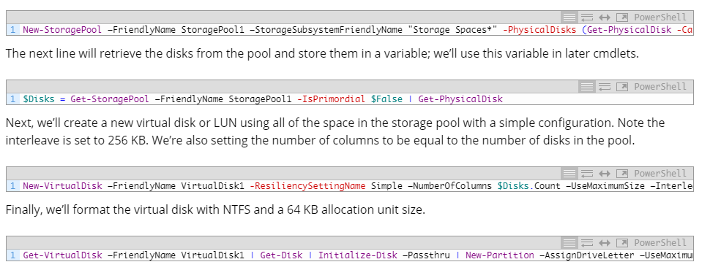
Implementing storage space–based volumes
Log into the guest OS of the virtual machine.
Launch PowerShell and run some PowerShell cmdlets. You can write a script and run this instead if you want to minimize human effort.
Next, we’ll run the following cmdlets. The first cmdlet will create a storage pool, which is the domain of performance and fault tolerance. Stated differently, any virtual disk that you create is spread across all the disks of a storage pool. If you want to maximize the performance of two data volumes, such as SQL Server logs and database file volumes, then create two storage pools using two sets of data disks.

